Slide 1

Sign language to text conversion
by
Konanki Rishitha Chowdary 421174
Datla Krishna Karthik Varma 421132
Under the guidance of
Dr.Srilatha
Department of Computer Science and Engineering
National Institute of Technology,Andhra Pradesh
Tadepalligudem-534102,India
April,2023

Slide 2
Abstract
We aim to build a model that could convert sign language to text, making communication between differently-abled people and normal people easy. Along with the alphabet, we will also involve some common usage words so there is no need to sign each letter. This model can also be modified to display an entire sentence through Some series of signs. The proposed project uses computer vision to develop a sign language-to-text conversion system. The system will be capable of detecting hand gestures and translating them into respective text, allowing individuals who do not know sign language to communicate effectively with those who rely on it.

Slide 3
Introduction
Sign language is a unique form of communication that is used by millions of people worldwide who are deaf or hard of hearing. However, for people who do not understand sign language, it can be challenging to communicate with individuals who use it. This is where computer vision can play a crucial role in bridging the communication gap between deaf and hearing communities.
3

Slide 4
We have thought to walk through this project around all the alphabet For this, we have used a hand tracking module to detect hands and then we have resized it to only the size of the hand. We have then saved these images into a folder. We have trained the symbols accordingly.
Modules used:
OpenCV, numpy, hand tracking module, Sklearn, media pipe

Slide 5
Problem Statement
The problem addressed by this project is the communication barrier faced by people who are deaf or hard of hearing when communicating with the hearing community. Sign language is the primary means of communication for many deaf individuals, but it is not always understood by those who do not know the language. This results in limited communication and can lead to social isolation and exclusion.

Slide 6
Motivation
We communicate with each other by speaking, but when a dumb person wants to talk or a deaf person wants to listen traditional conversation is not possible. So, then there arises a need for sign language. Although this sign language acts as a boon to these challenged people, this on the other hand causes difficulty for normal people to understand. So, the main motivation behind choosing this project is to implement a model which could convert sign language to text.

Slide 7
Methodology
The system is designed to use a camera to capture video of a person signing, and then use opencv algorithms to recognize the signs being made. The they are trained using a large dataset of sign language images, which includes examples of a wide range of signs and gestures. The system uses a Sklearn based model that is trained on images of sign language gestures. The model is trained to identify the signs being made in real-time video feeds. The system first detects the hand, then tracks the movement of the hand and determines the sign being made. The system then outputs the corresponding text in real-time.

Slide 8
Preliminary Result:
Dataset
We created our dataset by taking images from a laptop web camera and then converting them to grayscale images. We have then resized them to the same frame size and stored them in respective folders. We have taken 250 images for each sign and stored them in respective folders.
VGG16

Slide 9
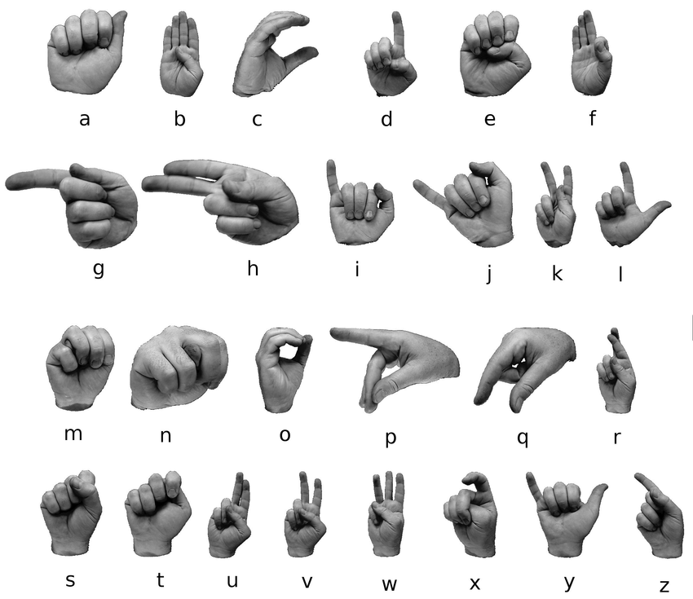
Signs Used

Slide 10
Experimental Procedure
The system is designed to use a camera to capture video of a person signing, and then use OpenCV algorithms to recognize the signs being made. They are trained using a large dataset of sign language images, which includes examples of a wide range of signs and gestures. The system uses a Sklearn based model that is trained on images of sign language gestures. The model is trained to identify the signs being made in real-time video feeds. The system first detects the hand, then tracks the movement of the hand, and determines the sign being made. The system then outputs the corresponding text in real-time.

Slide 11
Data Collection: For collecting data, we first created a new directory called 'data' using the OS module in Python. Then we have set the no of classes and also the data set size. For every class, we have created a separate folder in the directory and have collected images equal to the data set size, and joined them to the folder. We should also make sure that we have given images in all possible orientations in order to train the model better. Data Preprocessing: Preprocess the collected dataset by extracting individual sign gestures from the videos, normalizing the lighting conditions, and segmenting the signs based on the Image annotations.

Slide 12
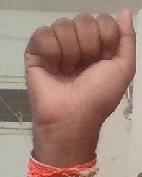
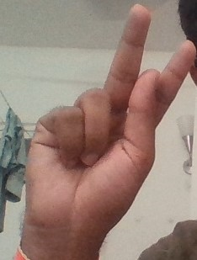
Training Data
A
K

Slide 13
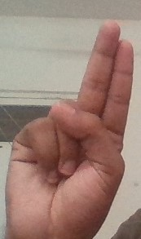
U

Slide 14
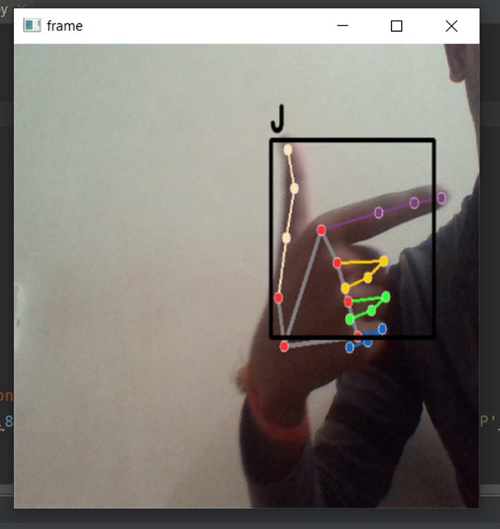
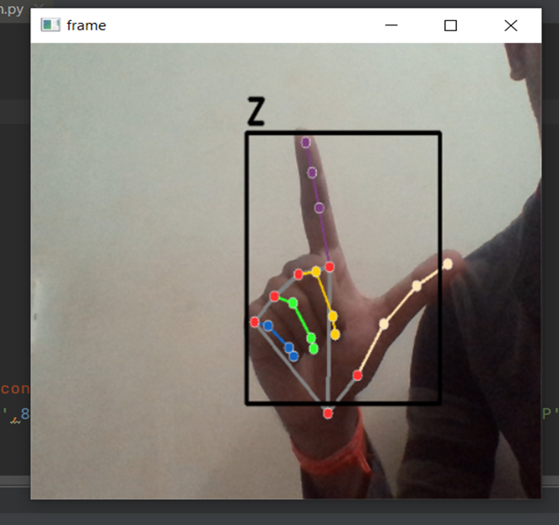
Testing Data
J
Z

Slide 15
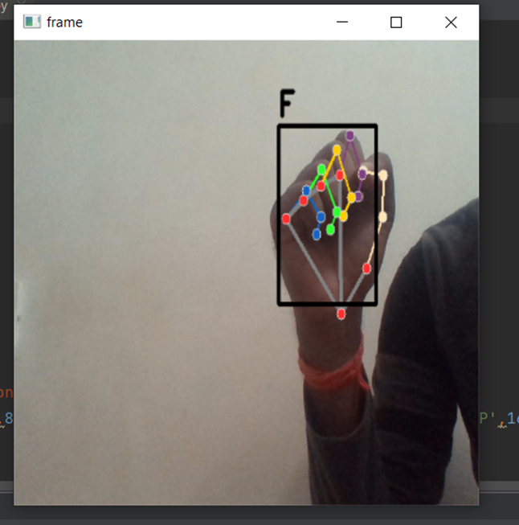
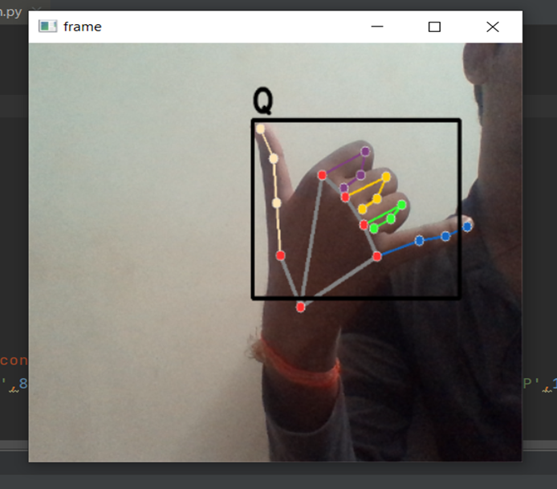
F
Q

Slide 16
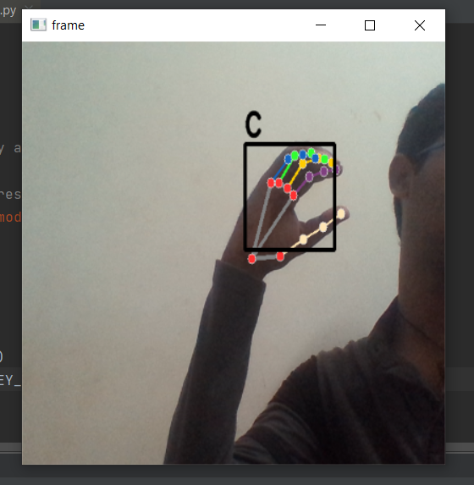
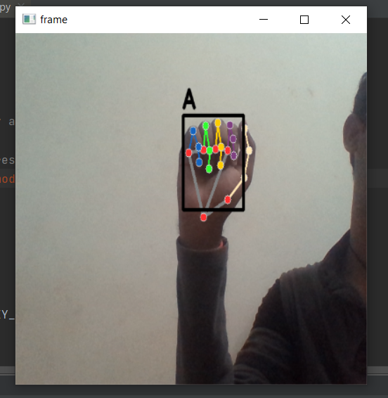
C
A

Slide 17
Problems faced
While training the signs, we encountered problems when two signs have nearly similar positions of nodes. And another problem was it is taking a lot of time while using Sklearn to train the data.

Slide 18
Future Scope
Incorporating Facial Expressions and Body Language:
Sign language is not just about hand gestures; facial expressions and body language play an important role in conveying meaning. Future research could focus on developing computer vision techniques that can recognize and interpret facial expressions and body language in sign language videos.
Developing Sign Language Translation Systems:
Sign language recognition systems are only one part of the puzzle. Future research could focus on developing sign language translation systems that can automatically translate sign language to spoken or written language in real-time.

Slide 19
Integration with Augmented Reality:
Augmented reality (AR) technology can overlay virtual objects onto the real world, creating an immersive and interactive experience. Future research could focus on integrating sign language recognition systems with AR technology to create a more engaging and interactive communication experience for people who are deaf or hard of hearing.
Expanding to Other Sign Languages:
Sign languages are not universal, and there are over 300 different sign languages in use worldwide. Future research could focus on developing sign language recognition systems for other sign languages, such as British Sign Language, French Sign Language, or Japanese Sign Language.

Slide 20
Conclusion
The system for converting sign language into text is a promising technology that could help improve communication for deaf and dumb individuals. The system uses Opencv algorithms and a Sklearn based model to recognize signs being made in real-time video feeds. The system has been shown to have a medium level of accuracy when tested using American Sign Language. Further research and development are necessary to make the system more robust and accurate for use in a wide range of settings and languages.

Slide 21
THANK YOU

